Slide 1
SECURE DATA HIDING IN IMAGES USING STEGANOGRAPHY
CAPSTONE PROJECT
Presented By : V SAI SIRI CHANDANA
Student Name : V SAI SIRI CHANDANA
College Name : RAGHU ENGINEERING COLLEGE
Department : CSC(CYBER SECURITY)

Slide 2
OUTLINE
Problem Statement
Technology used
Wow factor
End users
Result
Conclusion
Git-hub Link
Future scope

Slide 3
Problem Statement
In today's digital world, sensitive data is at risk of interception and unauthorized access. Traditional encryption methods, while secure, often attract attention, making the hidden information a target for attacks. There is a need for a more discreet method of secure communication that does not raise suspicion. This project addresses the problem by using steganography to embed secret messages within images, ensuring both confidentiality and invisibility. The goal is to develop a secure, efficient, and undetectable technique for data hiding in images.

Slide 4
Technology used
The program is written in Python, a widely used language for image processing and cryptography applications.
The libraries used in this program are:
OpenCV (cv2): Used for image reading, manipulation, and saving the encrypted image.
OS Module: Used to interact with the operating system and open the encrypted image automatically.
String: Provides various functions and constants for handling and manipulating strings efficiently

Slide 5
Wow factors
Unlike complex cryptographic methods, this project demonstrates a straightforward way to hide messages in images using pixel manipulation, making it easy to understand and implement.
The program works efficiently without requiring heavy encryption algorithms, making it quick for encoding and decoding messages.
The image is automatically saved and opened after encryption, enhancing the user experience without requiring additional manual steps.
Works on multiple operating systems (Windows, Linux, macOS) with minimal dependencies, making it accessible for a wide range of users.

Slide 6
End users
Government & Intelligence Agencies
Corporate Companies
Business Professionals
Forensic Experts
Law Enforcement
Military & Defence Organizations
Banking & Financial Institutions

Slide 7
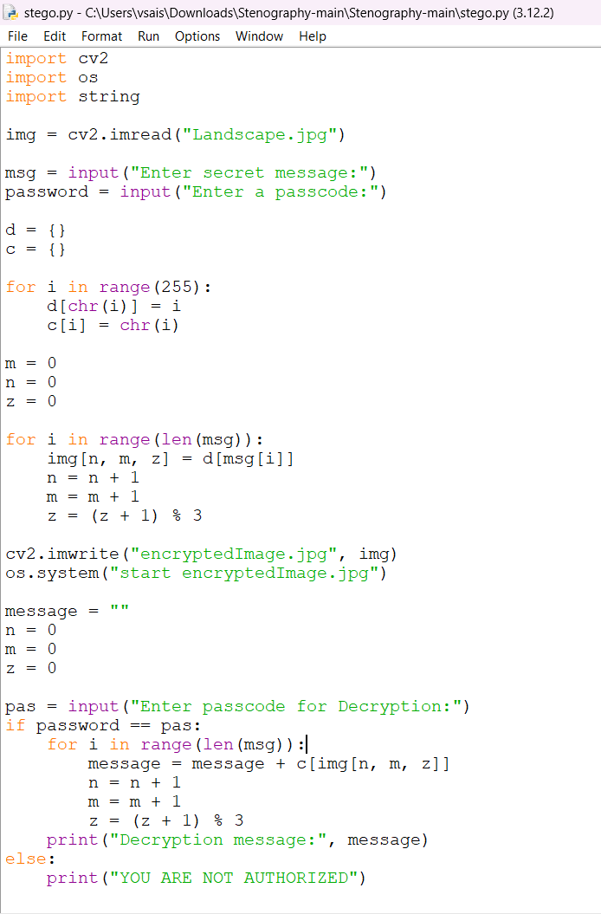
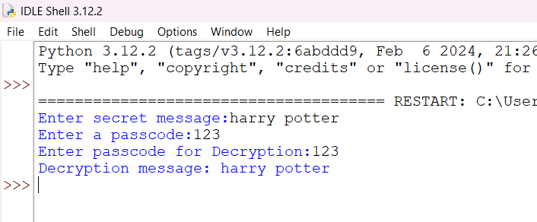
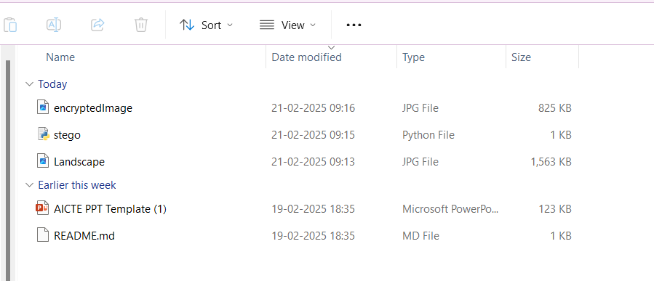
Results

Slide 8
Conclusion
This project successfully demonstrates a secure and efficient approach to hiding data within images using steganography. By utilizing pixel manipulation techniques, it ensures high invisibility while maintaining message confidentiality. The added passcode-based security enhances protection against unauthorized access. This method is lightweight, fast, and adaptable for various applications, from cybersecurity to secure communication.

Slide 9
GitHub Link
https://github.com/Siri4108/Steganography-project.git

Slide 10
Future scope
Multimedia Copyright Protection & Digital Watermarking
Protecting intellectual property by embedding digital watermarks in images, audio, and videos.
Artificial Intelligence & Machine Learning Security
Protecting AI model parameters by embedding them within images to prevent tampering.
Internet of Things (IoT) Security
Concealing sensitive IoT communication to prevent interception and attacks.
Augmented Reality (AR) & Virtual Reality (VR)
Embedding hidden messages or metadata within AR/VR content for immersive experiences.

Slide 11
THANK YOU

